Slide 1
Workshop 2021
November 30th

Slide 2
Hybrid Twin Concept Applied to ATL and FFF Processes

Slide 3
Concept
Real Data Components, Parts, Cars, Machines, … in Usage
Virtual Prototyping
Virtual Analysis based on Simulation which:
take into account the real physics
are repeatable and numerical stable
are predictive and validated
Real Life Application which:
provides problems & issue in usage
deliverers a huge amount of information
may provide unexpected responses
The Hybrid TwinTM
System Model
Simulation of Full System in Usage
System Model
Simulation of Full System in Usage
Smart Virtual Prototyping
Data Analytics
& Machine Learning
Virtual Twin
Digital Twin
Virtual Analysis in REAL TIME which:
take into account the real physics
are predictive and validated
use specific techniques – like system simulation, model order reduction or machine learning - to be applicable in real time
Data Driven Analysis which:
is based on many sensors or devices
has an enormous size
is used for data analytics
use specific techniques – like system simulation or machine learning - to be applicable in real time
is the connection between Virtual & Digital Twin
provides real time solutions for occurring problems and issues based on measured data, predictive models and right decisions

Slide 4
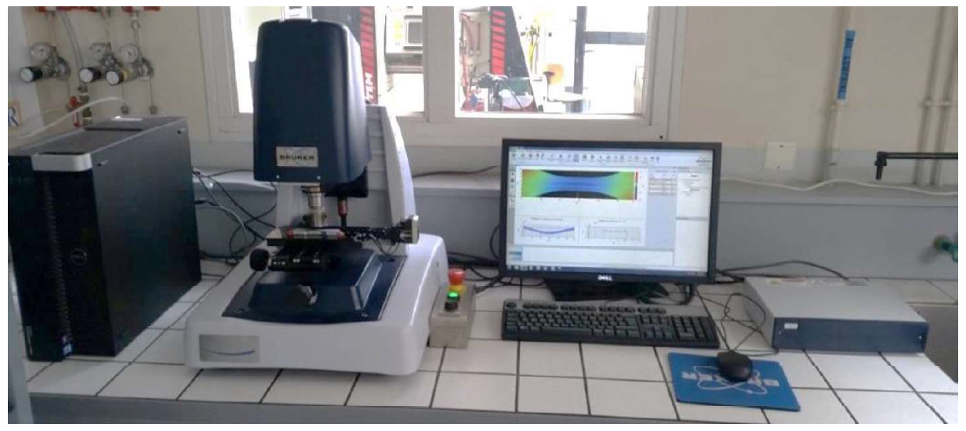
Properties
Specification of material parameters with their intrinsic variability
Material viscosity (and its termo-dependency)
Thermal properties (and their termo-dependencies)
Geometrical properties
Surface descriptors

Slide 7
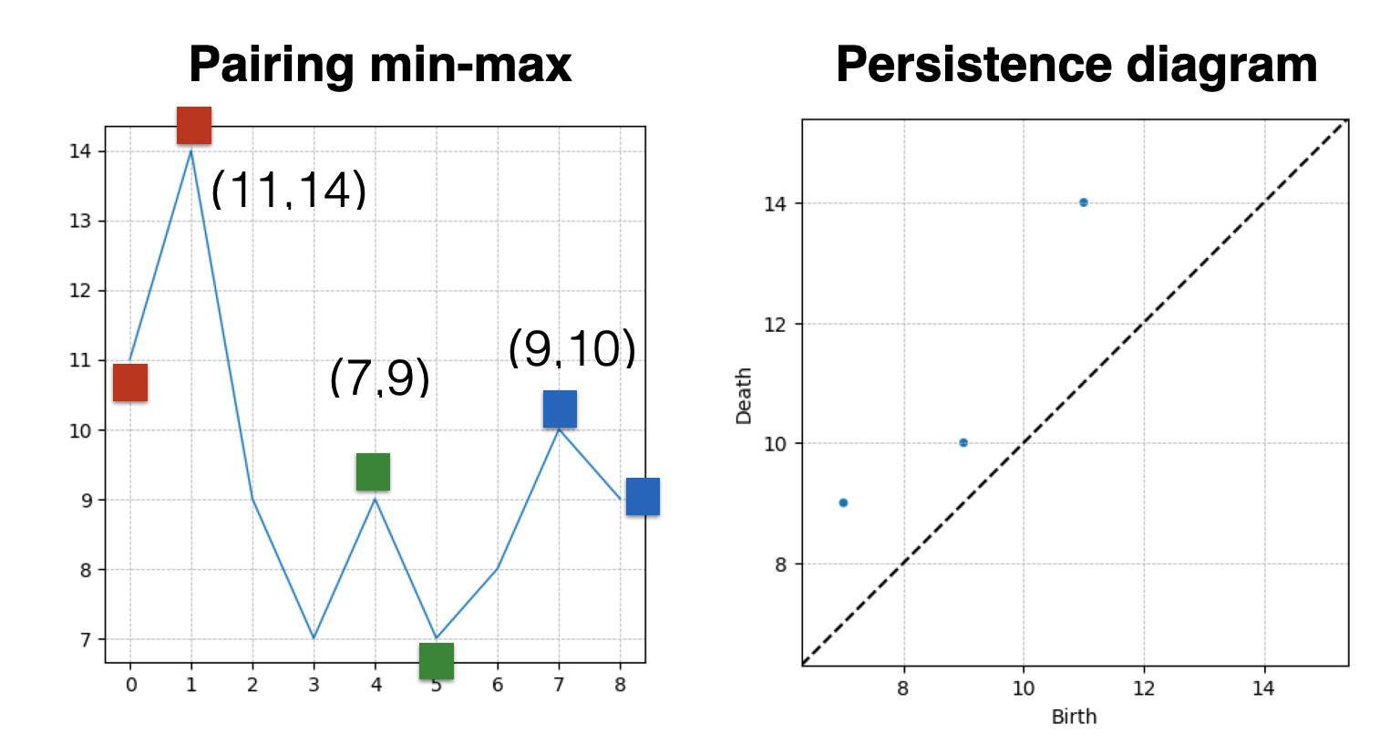
TDA 1D

Slide 8
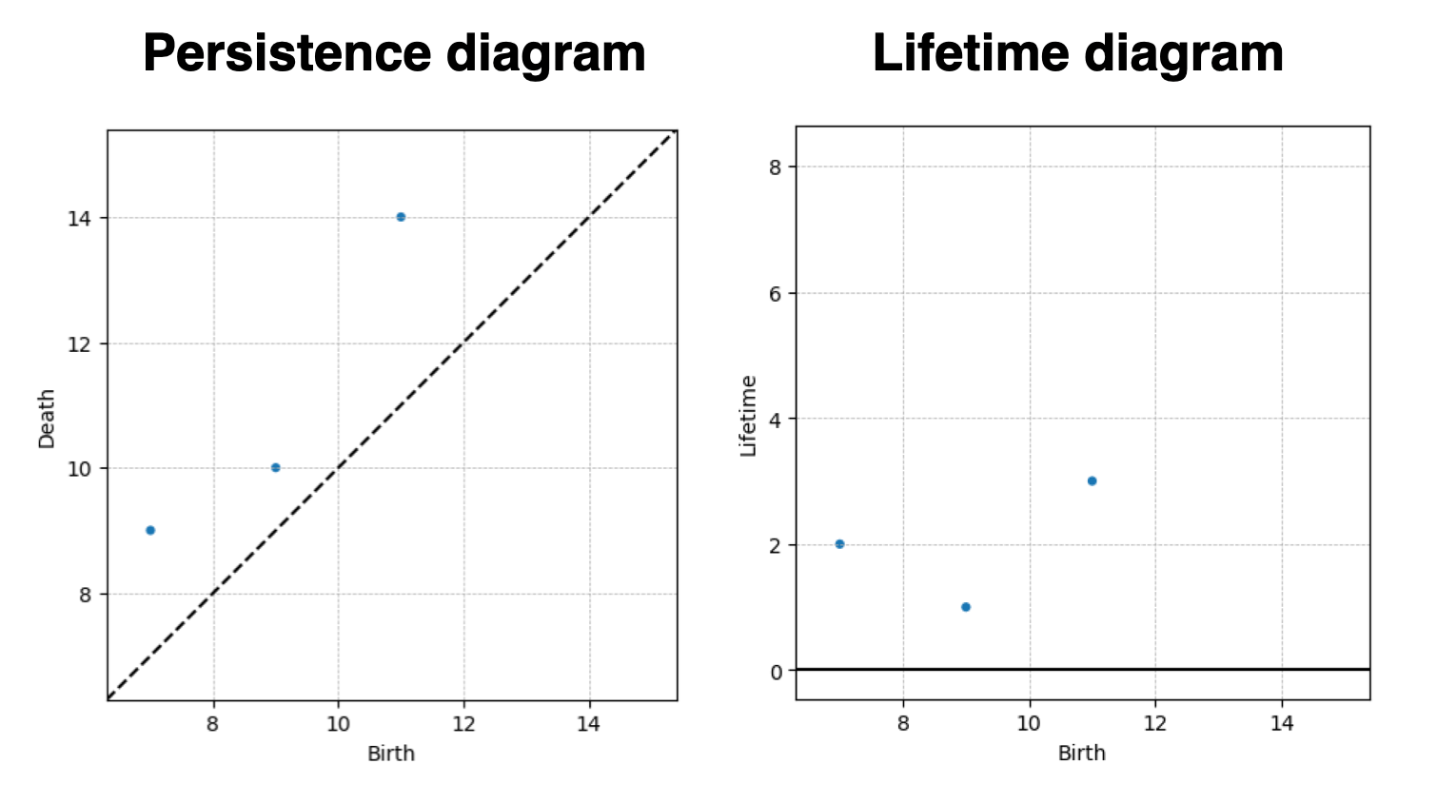

Slide 9
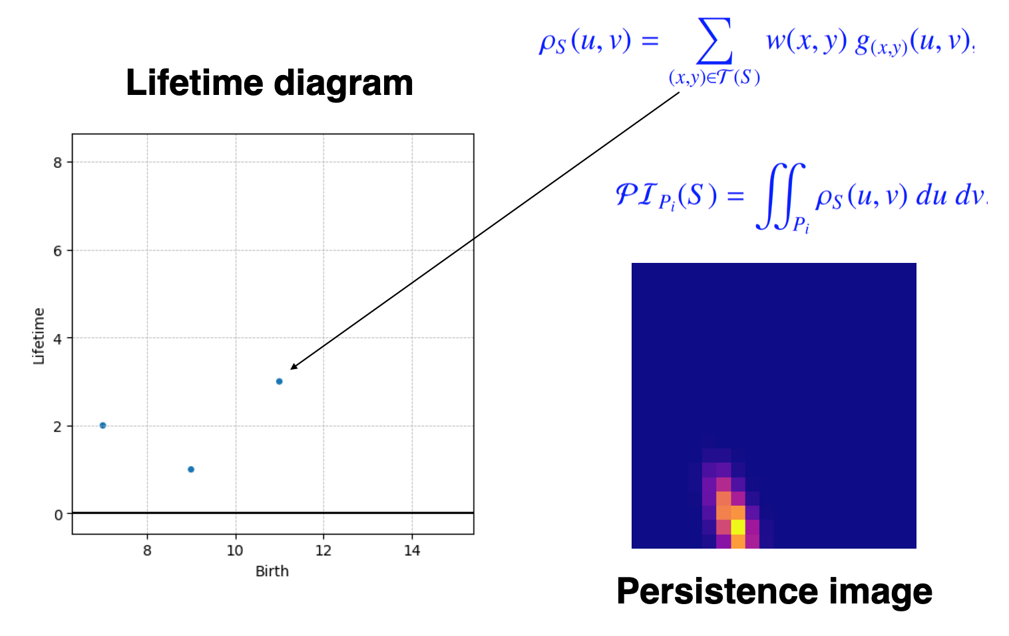

Slide 10
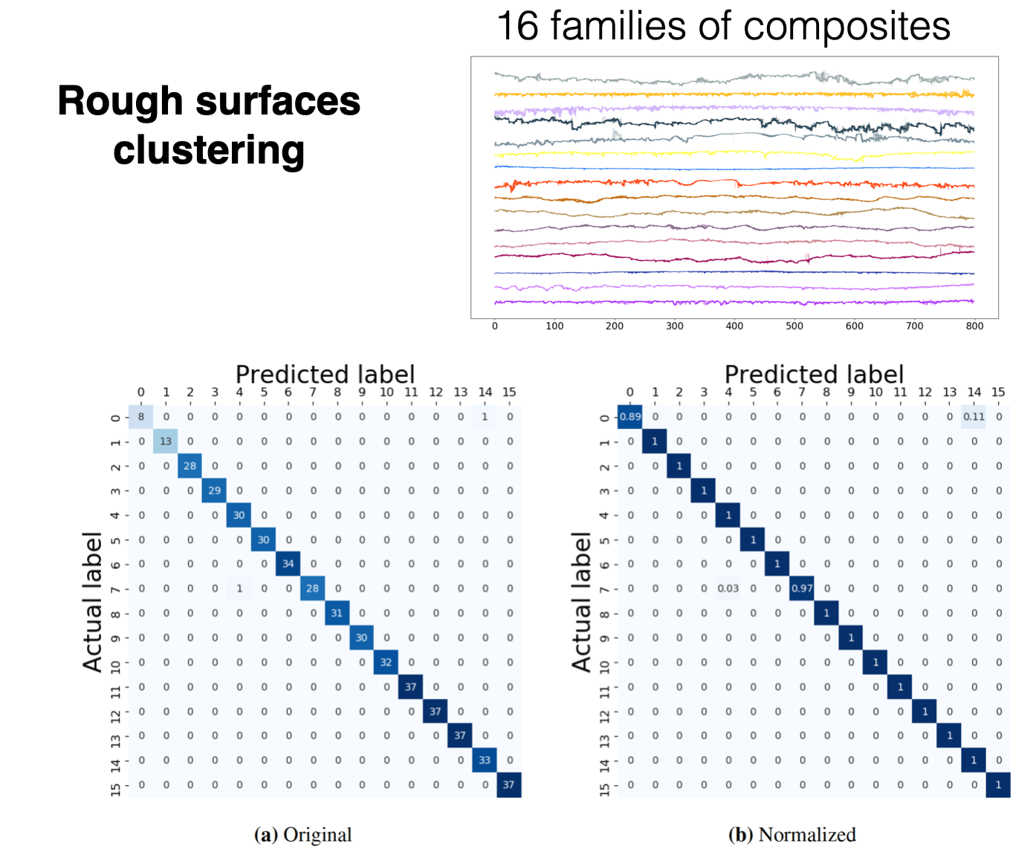

Slide 11
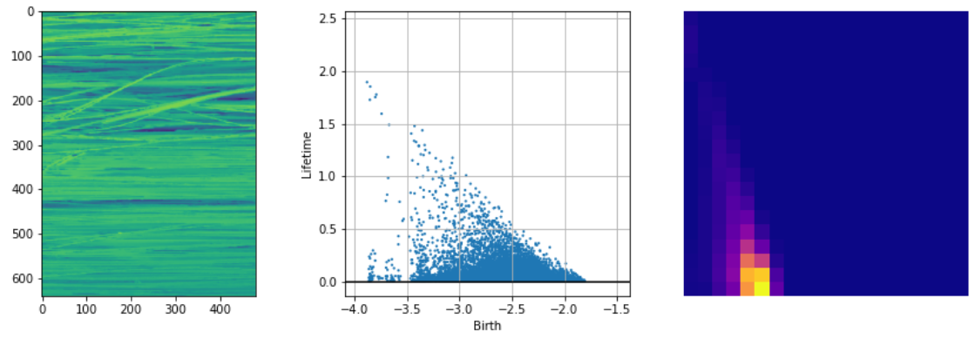
TDA 2D

Slide 12
Lay-Up & Consolidation
Lay-Up and Consolidation Process
Lay-Up simulation: FEM and Model Order Reduction
Simulating consolidation: Fine scale FE simulation
Linking inputs and outputs: Machine learning

Slide 13
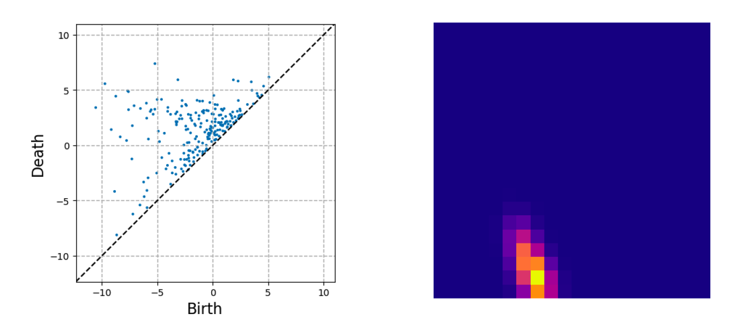

Slide 14
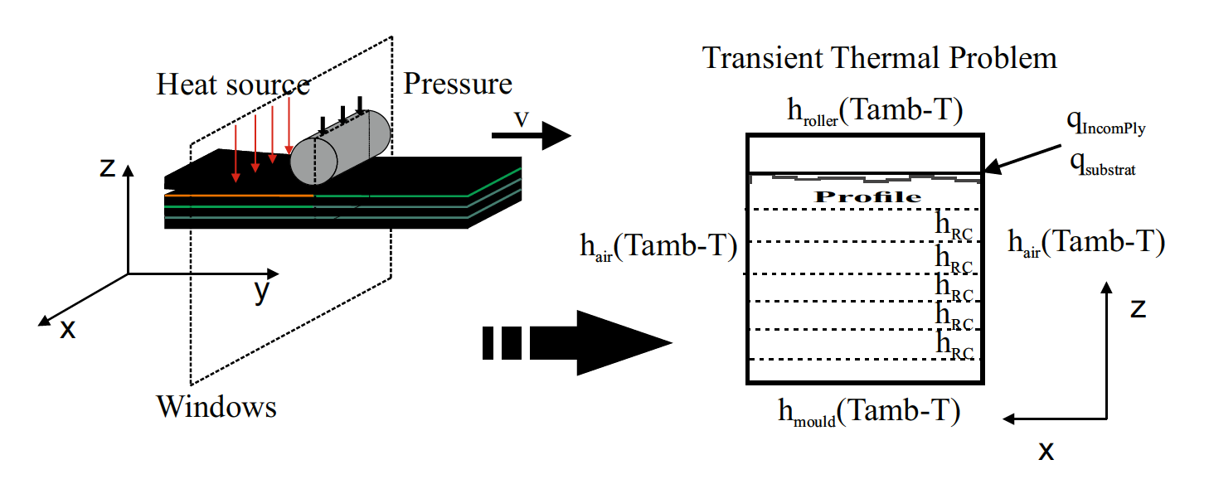

Slide 15
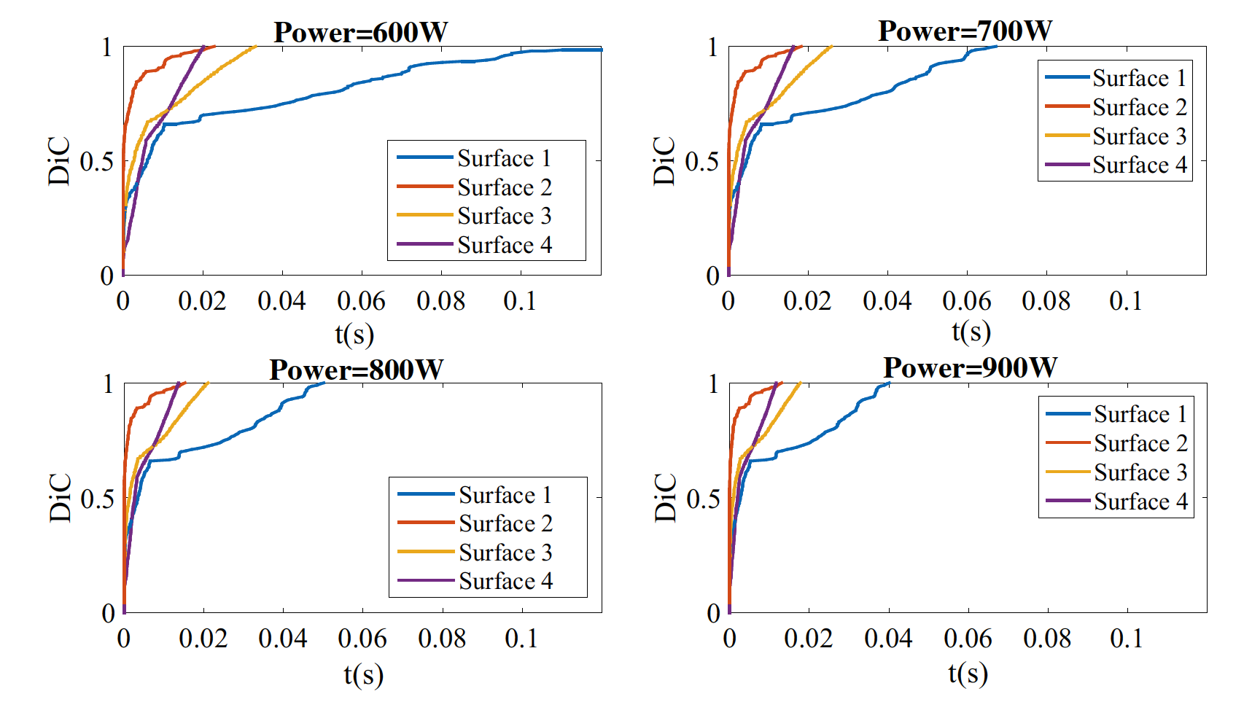

Slide 16
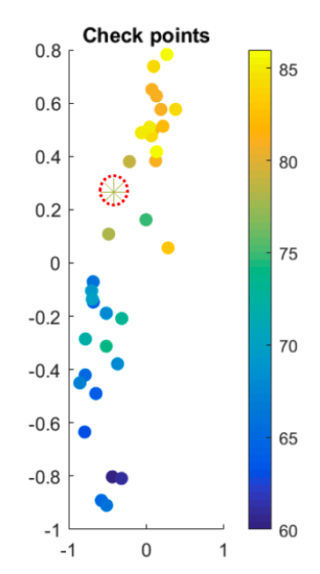
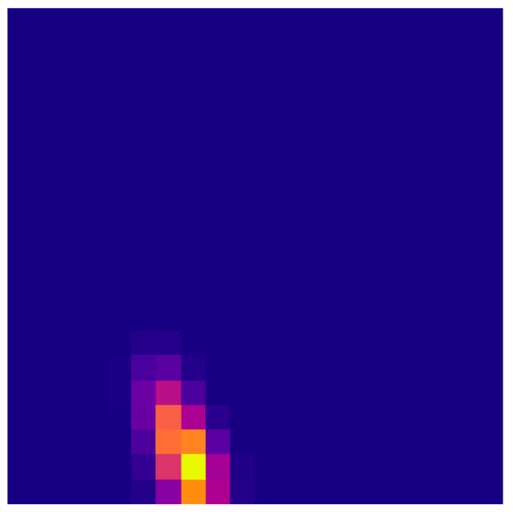

Slide 17
FFF
FFF Process Modeling
Extracting morphology from experiments & Simulations
Parameter bounds were defined with AIMEN, DOE to be defined
Current nozzle design was provided by IPC; model creation is ongoing
Defining morphology descriptors
Achieved on an abstract level
Awaiting experimental data for specific material and process conditions
Linking filament characteristics with material and process parameters via machine learning
Awaiting experimental data

Slide 18
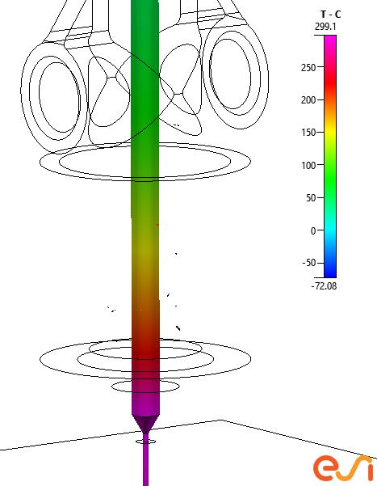
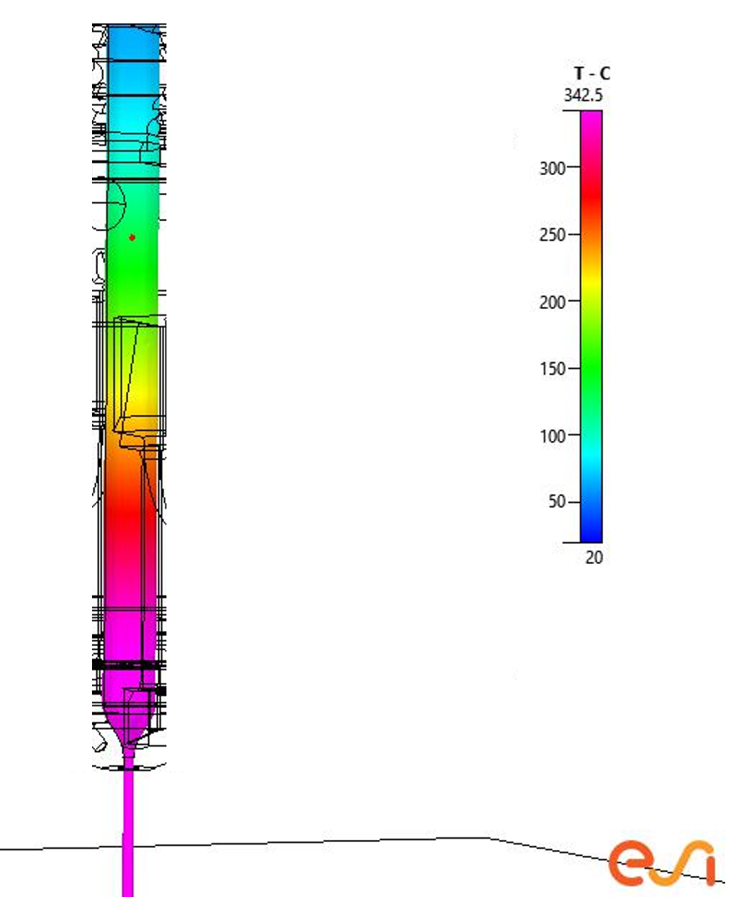
FFF
Nozzle Design
Comparison of different designs
Design 1
Design 2

Slide 19
FFF
Filament shape prediction
Stand off distance: 0.8 mm
Feed rate = Scan speed = 2 mm/s
Assumed properties
1000 Pas
0.2 N/m
Contact angle = 180º
Contact angle = 0º

Slide 20
FFF
Filament shape prediction
Stand off distance: 0.3 mm
Feed rate = Scan speed = 2 mm/s
Assumed properties
1000 Pas
0.2 N/m
Contact angle = 180º
Contact angle = 0º

Slide 21
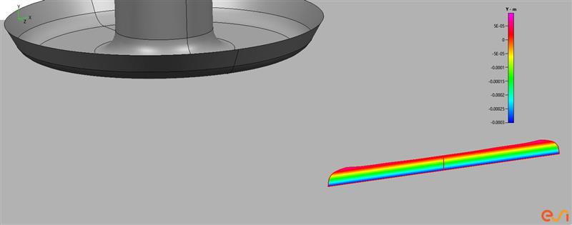
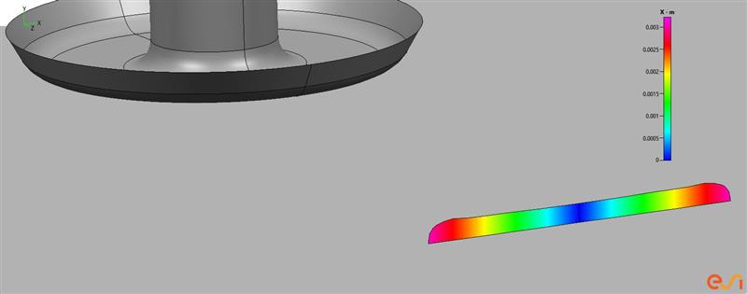
FFF
Filament shape prediction
Preliminary comparison with experiments
Standoff distance: 0.3 mm
Feed rate = Scan speed = 7 mm/s
Height: 0.4 mm
Width:6.1 mm

Slide 22
FFF

Slide 23
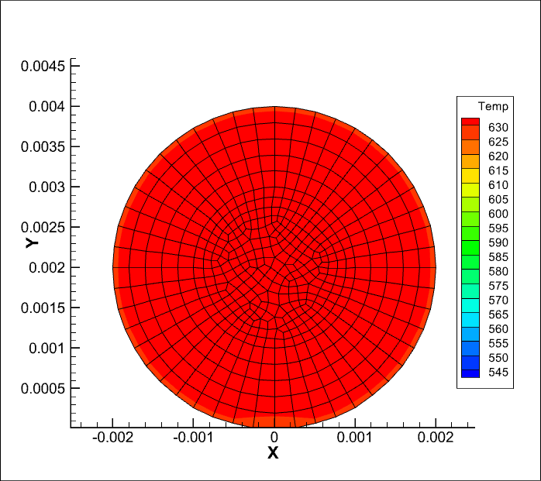

Slide 25
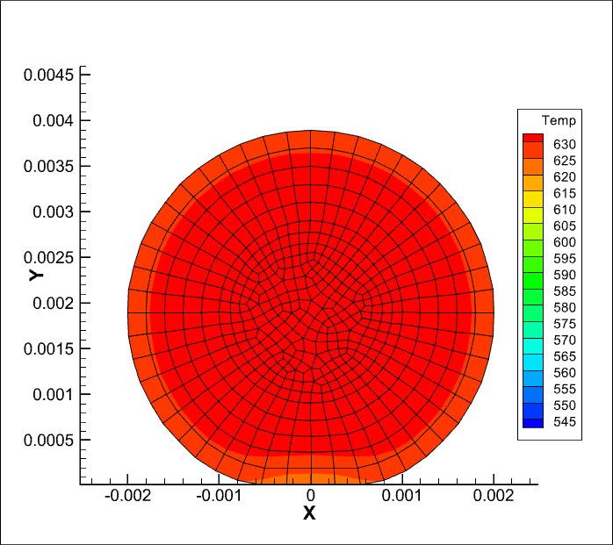

Slide 27
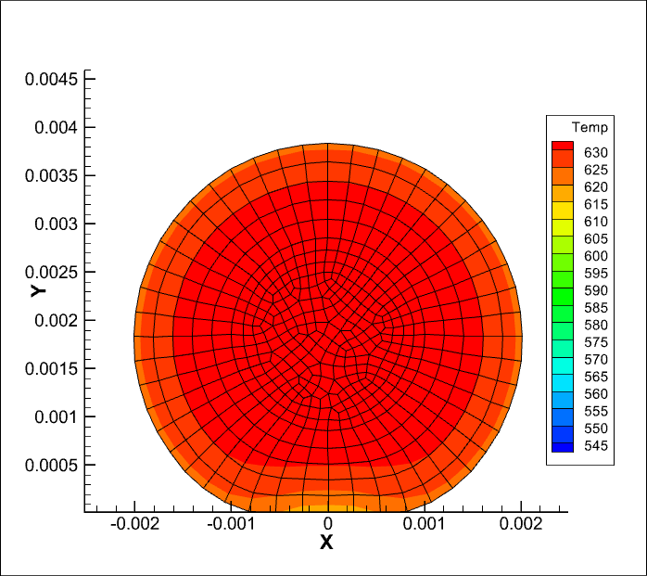

Slide 28
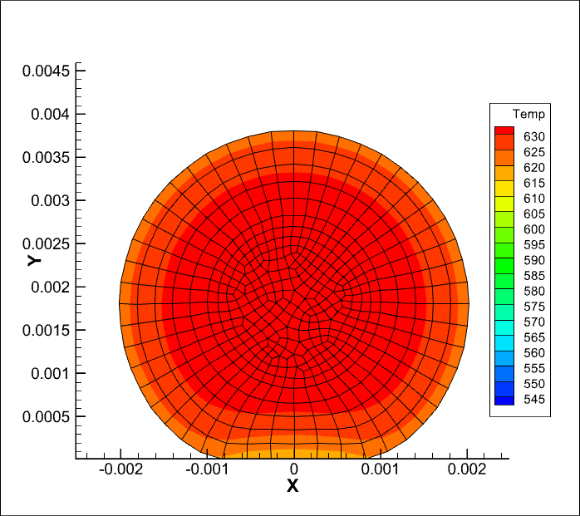

Slide 29
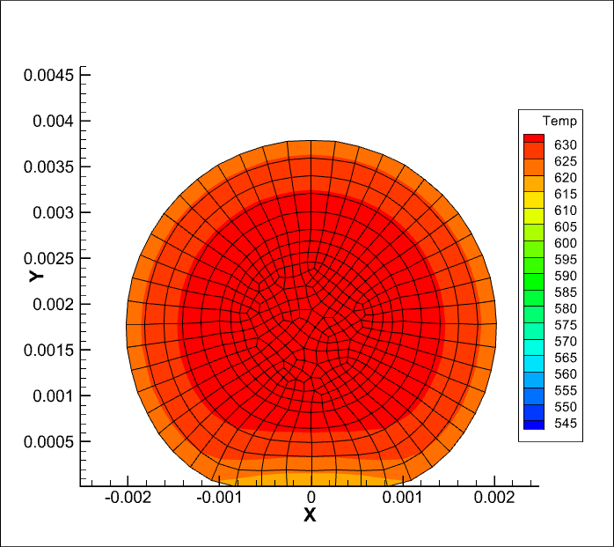

Slide 30
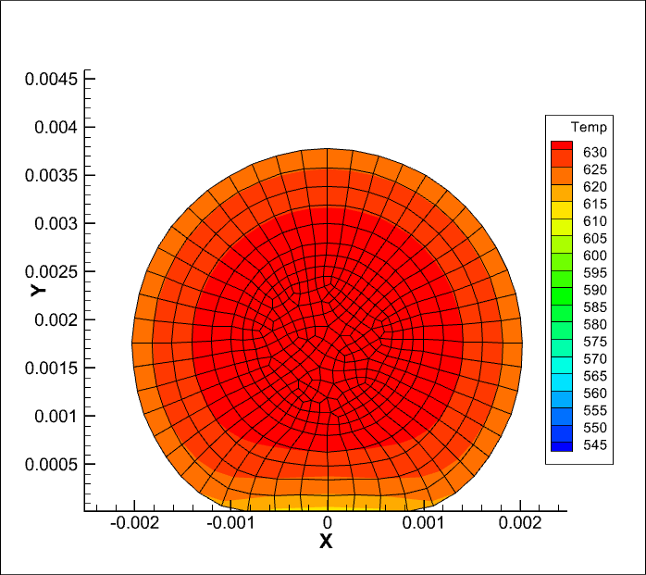

Slide 31
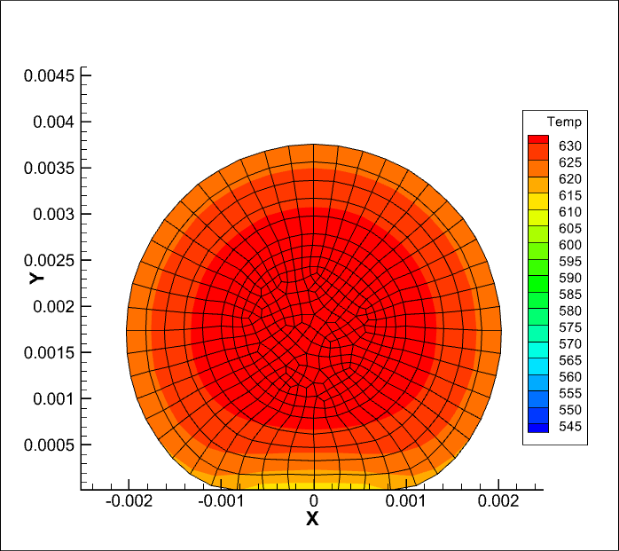

Slide 32
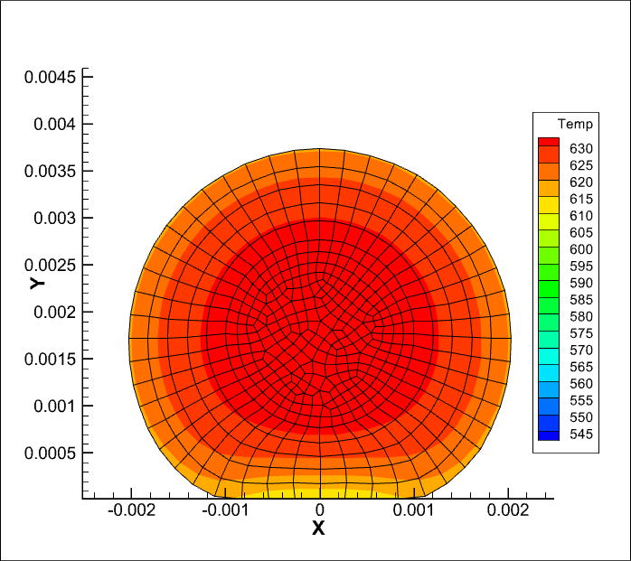

Slide 33
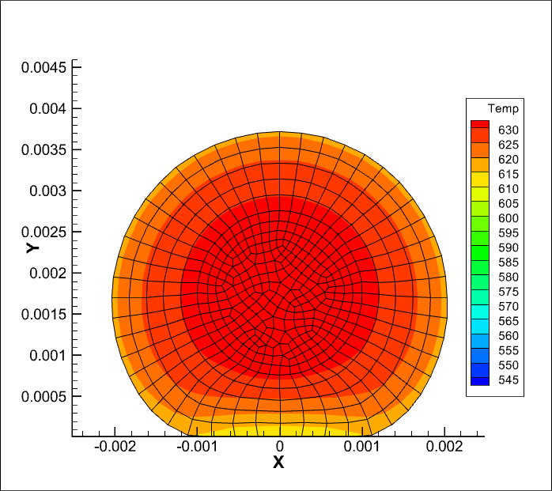

Slide 35
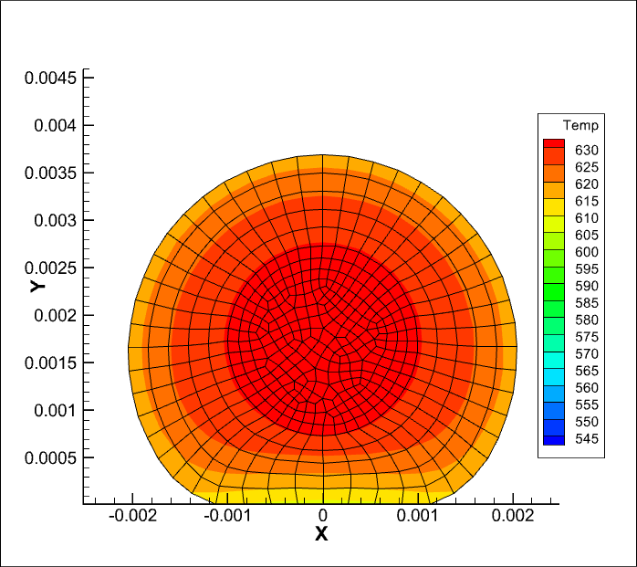

Slide 36
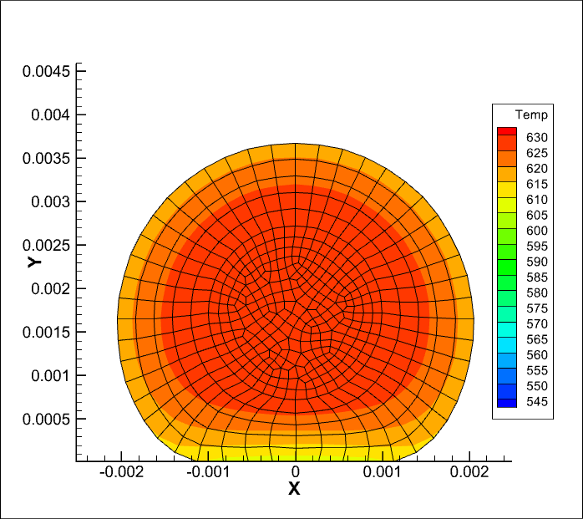

Slide 38
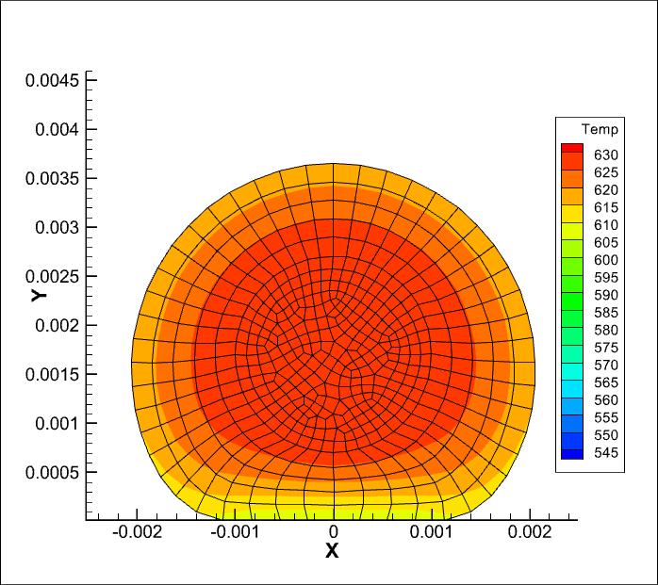

Slide 39
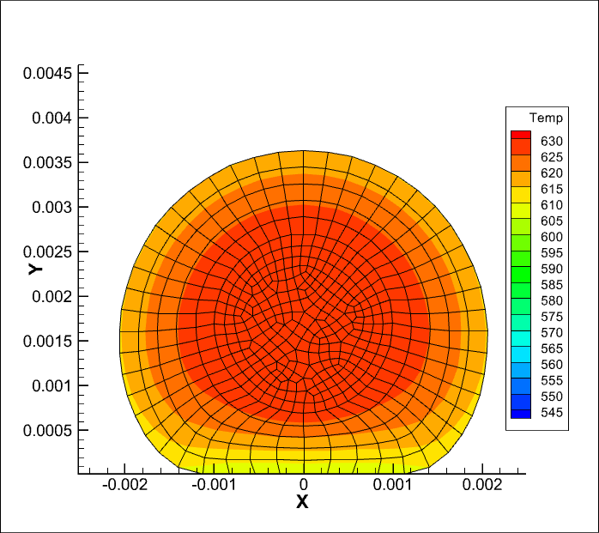

Slide 41
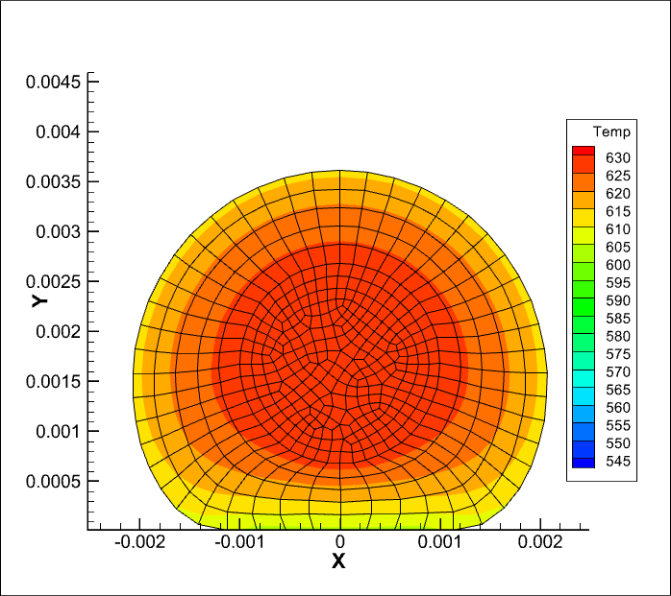

Slide 42
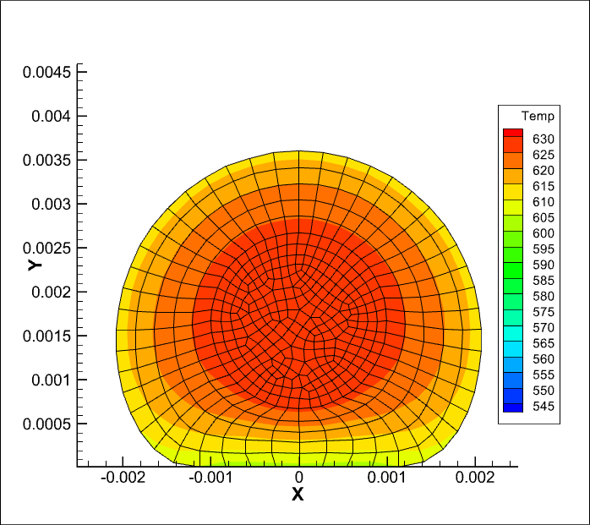

Slide 44
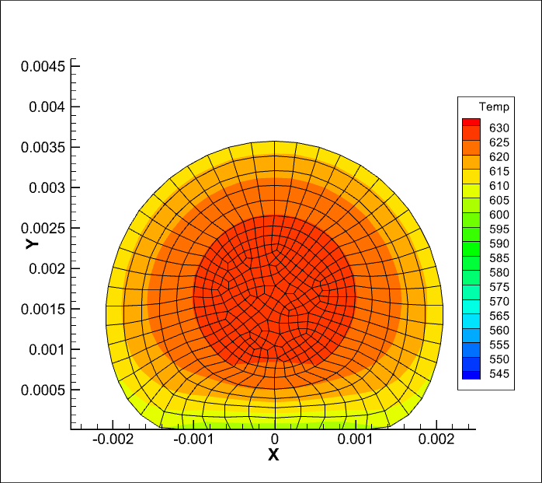

Slide 45
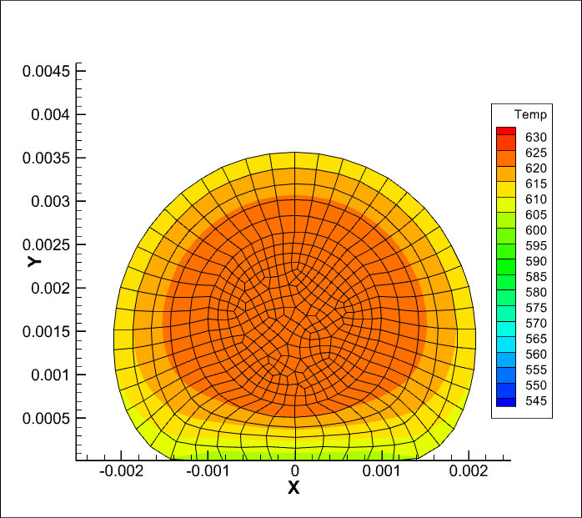

Slide 46
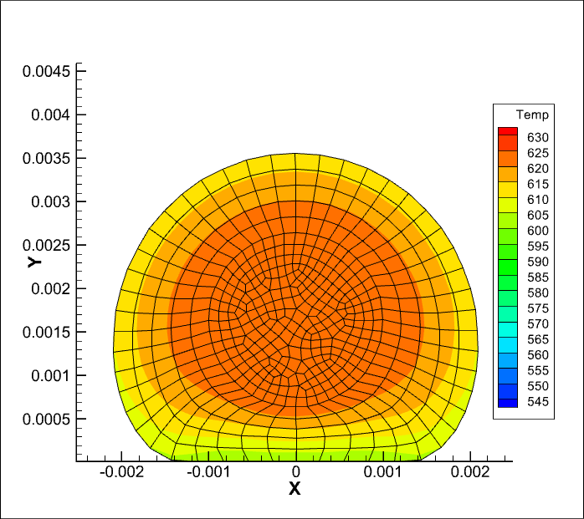

Slide 48
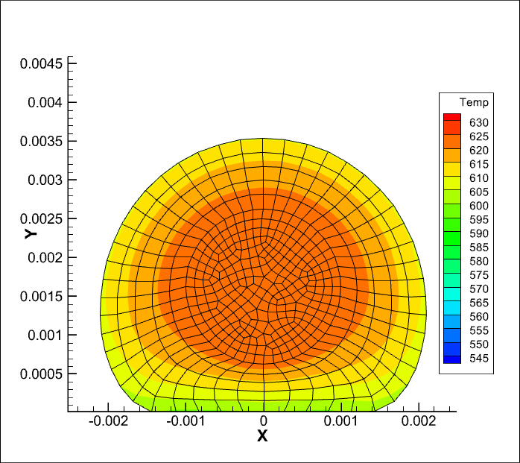

Slide 51
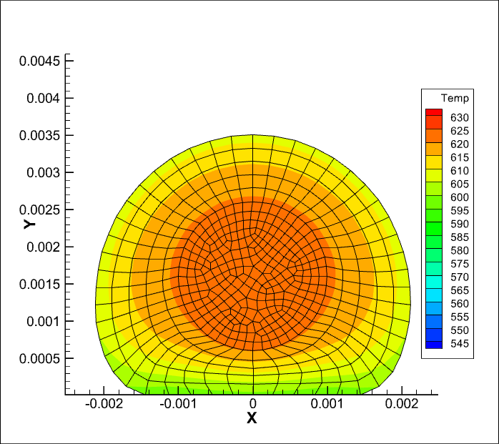

Slide 52
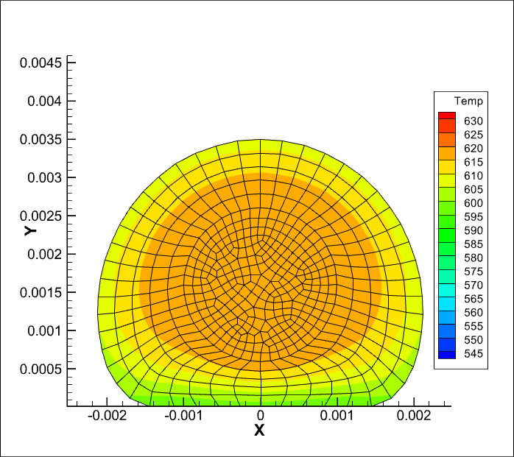

Slide 54
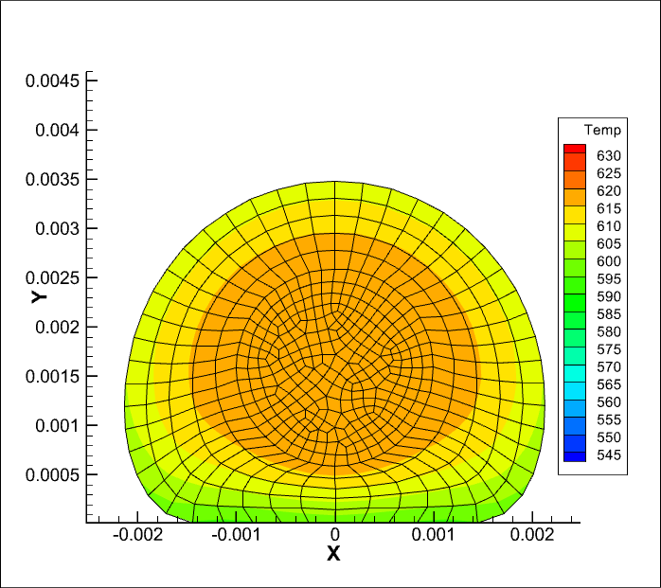

Slide 55
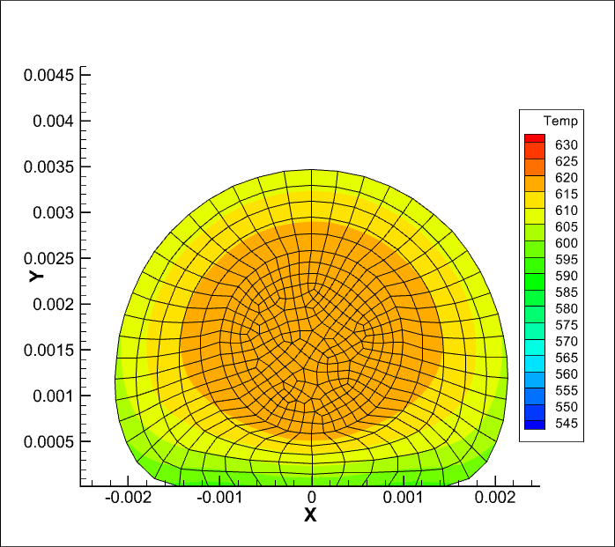

Slide 58
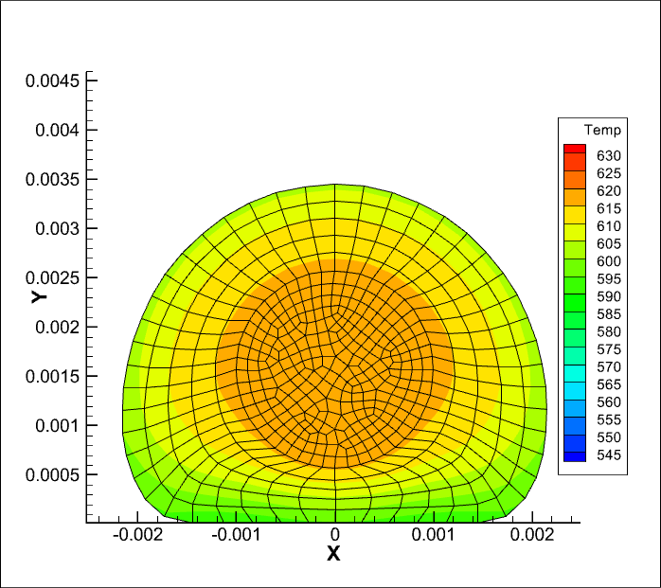

Slide 59
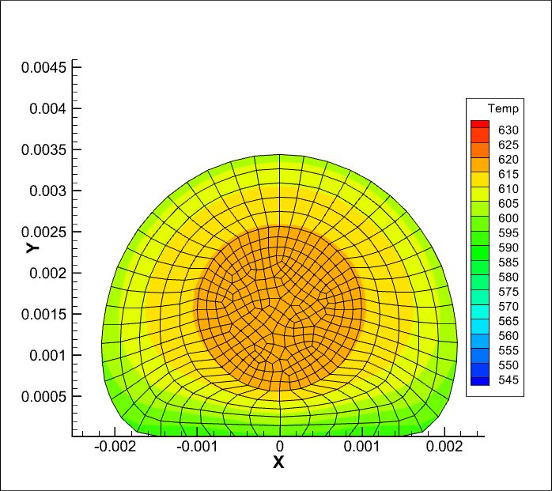

Slide 60
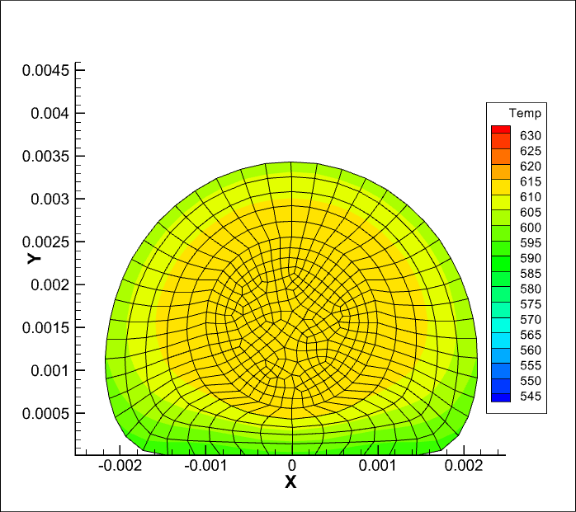

Slide 65
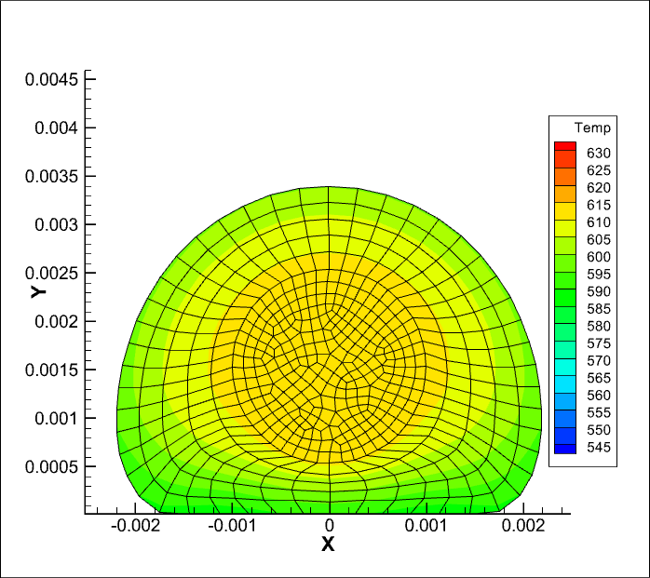

Slide 66
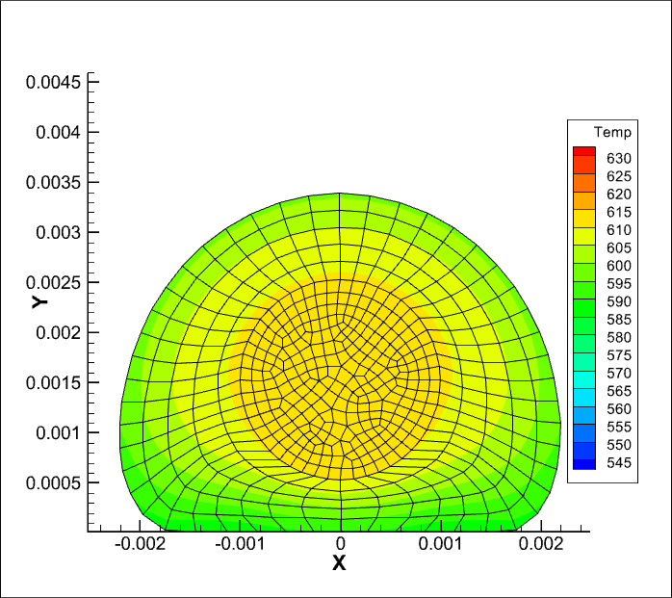

Slide 67
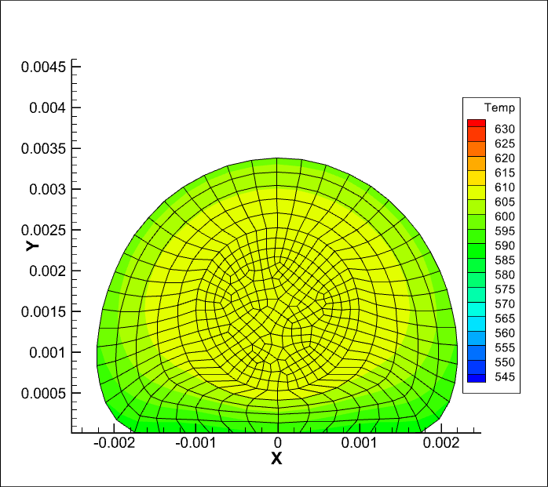

Slide 71
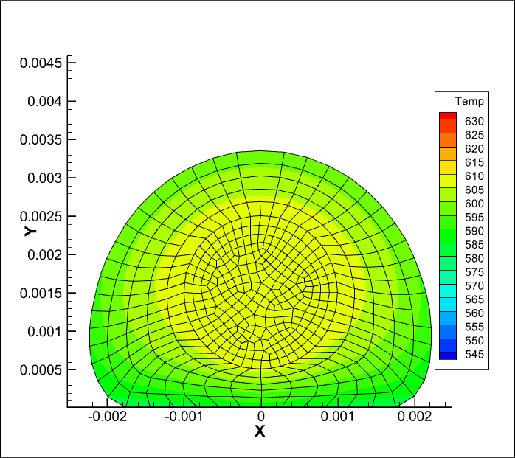

Slide 72
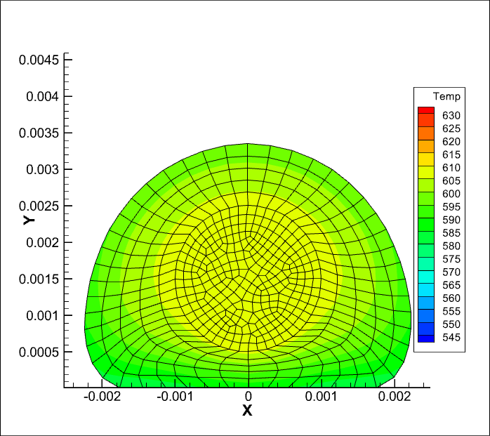

Slide 73
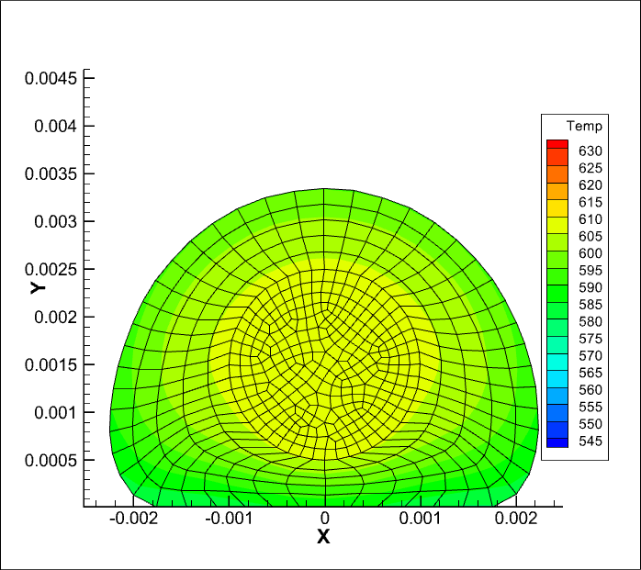

Slide 74
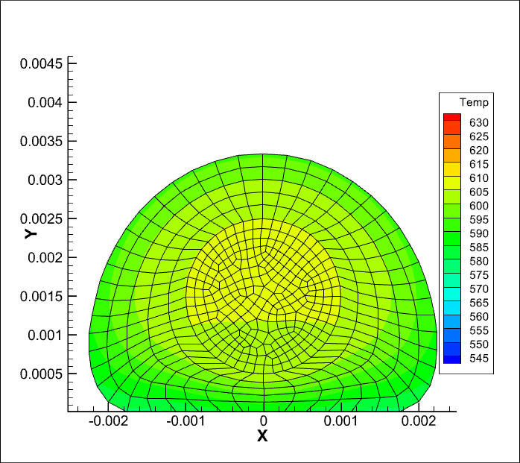

Slide 76
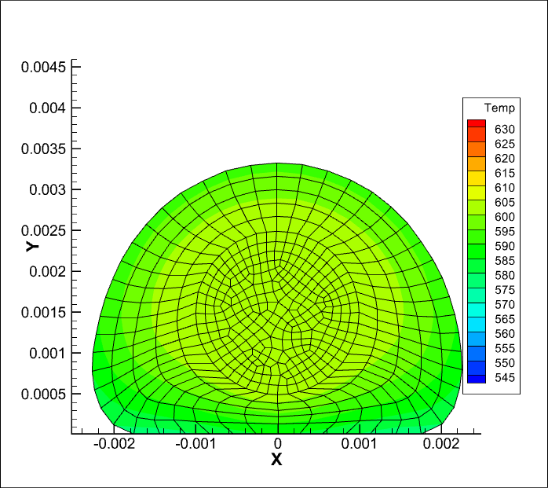

Slide 81
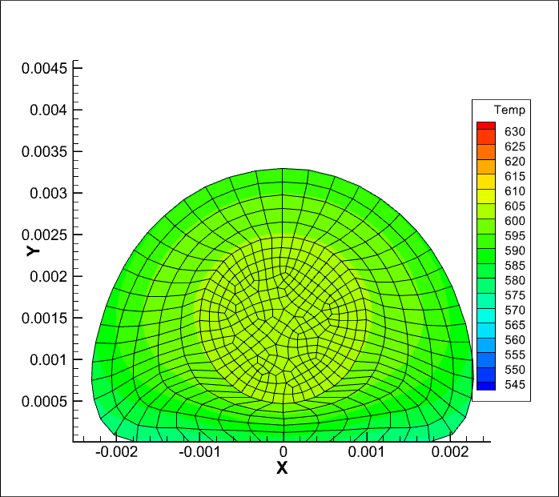

Slide 124
Conclusions
Data based modelling of ATL and FFF processes is pursued based on sensor and synthetic data.
Physics based models are being developed and validated for FFF process
The Hybrid Twin of the combined process chain is progressing towards improved planning and optimization of design and manufacturing processes.

Slide 125
CHINESTA, Francisco | Professor @ ENSAM 00 33 6 43646905 | Francisco.Chinesta@ensam.eu

